Slide 1
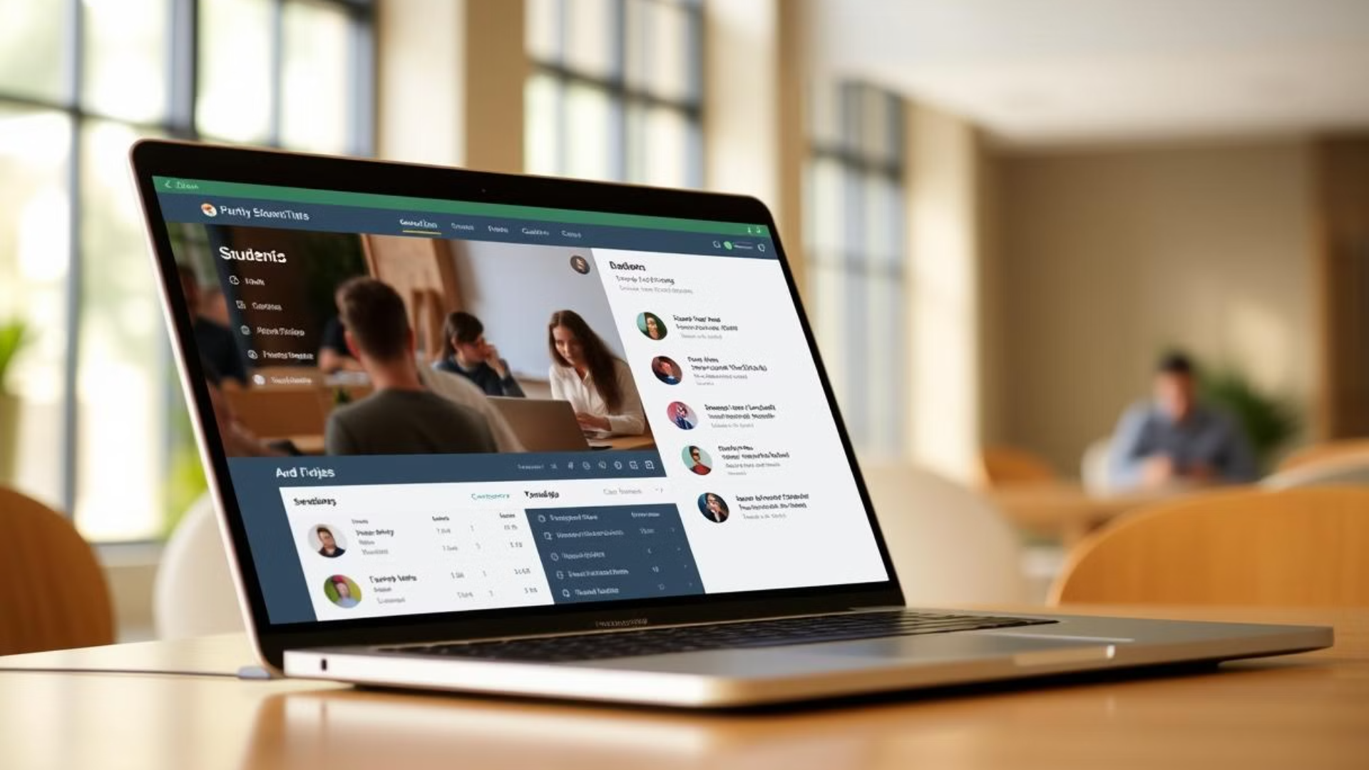
Track My Class: Streamlining your class Queries
A comprehensive Student Database Management System designed for universities and educational institutions, "Track My Class" simplifies academic data management and enhances communication.
"Track My Class" is a Student Database Management System (SDMS) developed using Flask, a lightweight Python web framework, and MySQL, a robust relational database management system. This system is designed to manage and streamline various aspects of student and academic information, including student profiles, class schedules, attendance tracking, and grade management

Slide 2

Abstract
Streamlining Data
Enhanced Communication
Track My Class, a Student Database Management System (SDMS), simplifies academic information management. It uses Flask for a lightweight web application and MySQL for a robust relational database.
The system provides a central platform for managing student profiles, course enrollment, attendance, and grades, improving communication between students, faculty, and administrators.

Slide 3
Requirements
Software Requirements
Hardware Requirements
Operating System: Windows 11 Pro
System: PC/Laptop
Front End: HTML, CSS, JavaScript, Bootstrap
Processor: Intel Core i3 / Intel Core i7
Back End: Python
RAM: 8.00 GB / 16.00 GB
Framework: Flask
Hard disk: SSD
Database: MySQL
Keyboard: Standard USB keyboard
Server: Local Server
Mouse: USB mouse, Track pad
IDE: PyCharm
Speaker: Hight -quality speaker
System type: 64-bit operating system
Graphics card: NVIDIA GeForce GTX 1660

Slide 4
Introduction: About the Project
Comprehensive Management
Automated Tasks
Real-Time Updates
The project aims to automate and simplify administrative tasks, reducing the burden on staff and improving data accuracy and accessibility.
The system enables students to create and manage personal profiles, view their academic records, enroll in courses, track attendance, and access real-time updates on grades and assignments.
Track My Class is a comprehensive SDMS designed to manage key aspects of academic administration for educational institutions.
Advanced Reporting
Administrators can access comprehensive data, including student records and performance analytics, through advanced reporting features.

Slide 5

Existing System: Challenges of Traditional Methods
Manual Record Keeping
Disjointed Software Solutions
Paper records or spreadsheets are prone to human errors, data loss, and inefficiencies. Handling large volumes of data manually is time-consuming and error-prone.
Using multiple disconnected software tools leads to inconsistent data, data duplication, and confusion about which software holds the most up-to-date information.
Limited Access and Security
Lack of Real-Time Updates
Existing systems may lack proper security measures, leaving sensitive student data vulnerable to unauthorized access or misuse. Access to student data is often limited, creating communication barriers.
The absence of real-time updates on academic progress or attendance can lead to delays in academic decision-making and feedback, resulting in students falling behind without timely interventions.

Slide 6
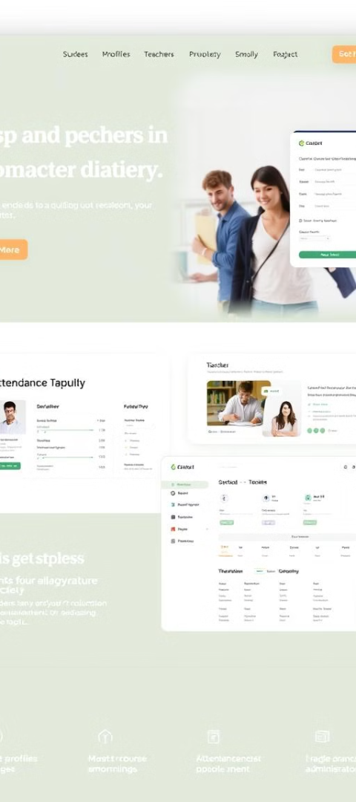




Proposed System: "Track My Class"
Student Registration
Course Management
New students can register with personal details and manage their profiles.
Teachers and administrators can create, update, and delete courses. Each course will have associated details like course name, instructor, and syllabus.
Attendance Tracking
Grade Management
Administrators and teachers can track student attendance for each course, with options to mark attendance for individual classes.
Teachers can assign grades and marks for each student in their respective courses.

Slide 7

System Workflow
User Authentication
1
Users (Admin, Teacher, Student) will log in using their credentials. Flask-Login manages user sessions and provides secure authentication.
2
Student Registration
Admins will add new students to the system via a registration form. The student's information will be stored in the students table.
Attendance Management
3
Teachers will mark attendance for each class session. The attendance data will be recorded in the attendance table and can be tracked by students and teachers.
4
Grade Management
Teachers will input grades for students after assignments, tests, or exams. These grades will be stored in the grades table, and students will be able to view their grades through their dashboards.
Reports and Analytics
5
Admins and teachers can generate reports, such as attendance records or grade reports, to analyze student performance.

Slide 8




User Roles and Permissions
Admin
1
Full access to all features.
Teacher
2
Can manage their own courses.
Student
3
Can view their profile, grades, and attendance.

Slide 9




Security Considerations
Password Encryption
Passwords will be securely stored using hashing (e.g., using Flask-Bcrypt).
Role-based Access Control
The system will implement role-based access control to ensure only authorized users can access certain functionalities.
SQL Injection Prevention
All database queries will be parameterized to avoid SQL injection attacks.
Session Management
User sessions will be securely managed to prevent unauthorized access.

Slide 10

Conclusion: Streamlining Education
Track My Class is a comprehensive solution for managing student information, attendance, and grades in a classroom or educational setting. Using Flask for the backend and MySQL for the database ensures that the system is scalable, secure, and efficient. This system provides a user-friendly interface for students, teachers, and administrators to interact with and manage academic data, helping to streamline educational administration and improve overall student tracking and performance monitoring.

